Slide 1

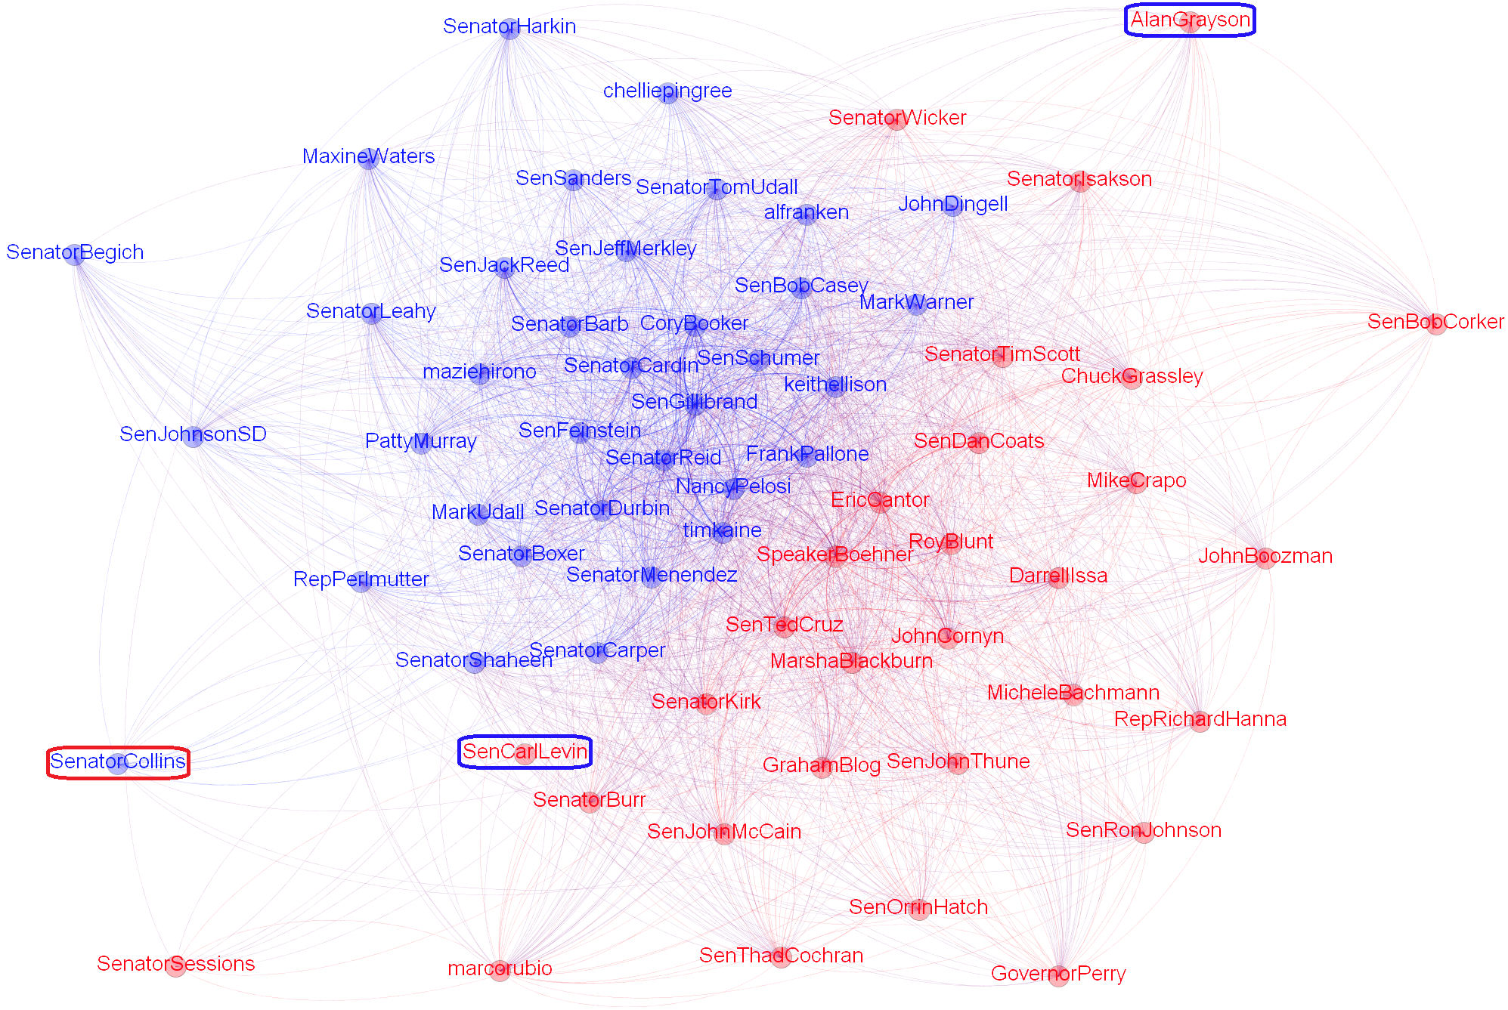
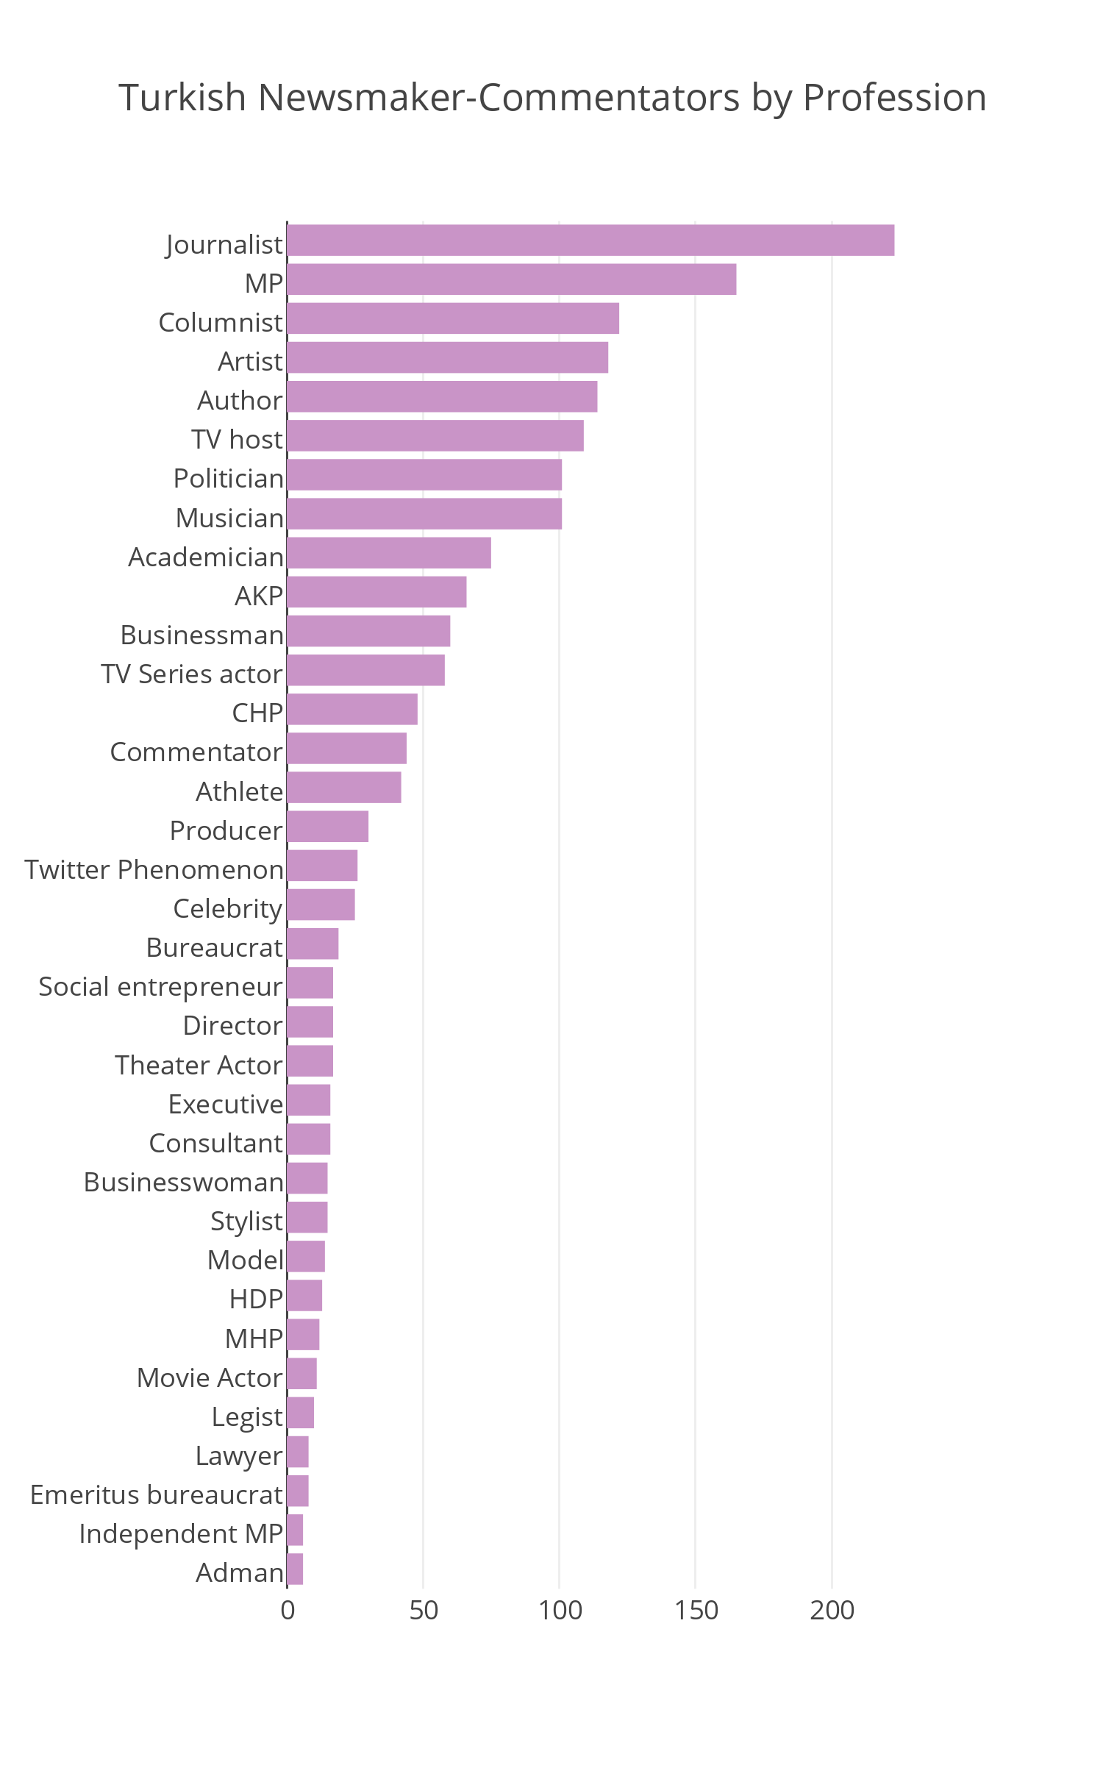
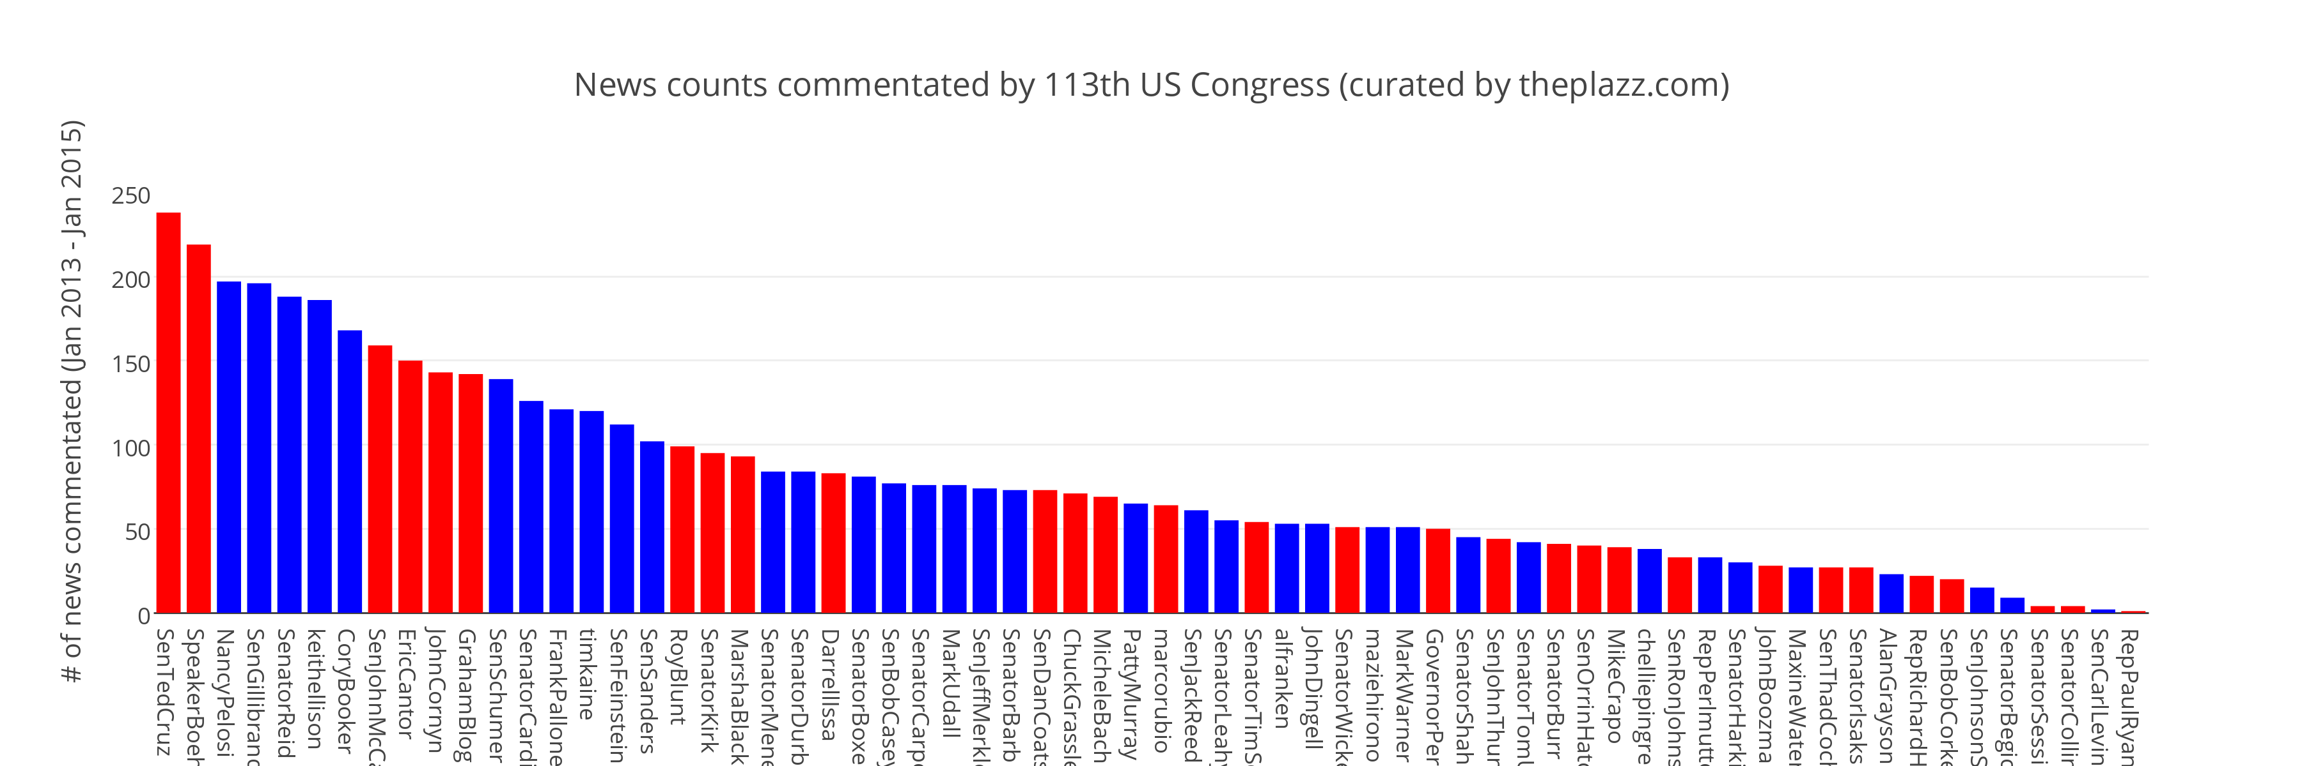
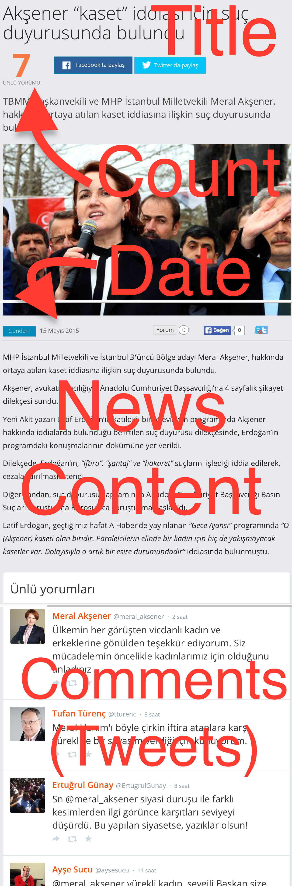
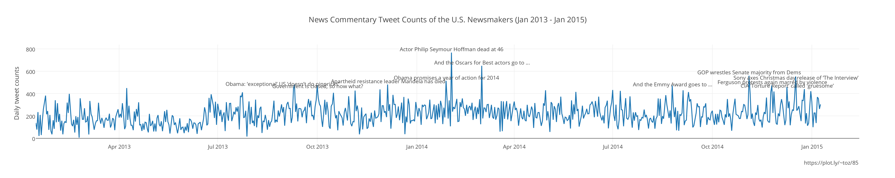
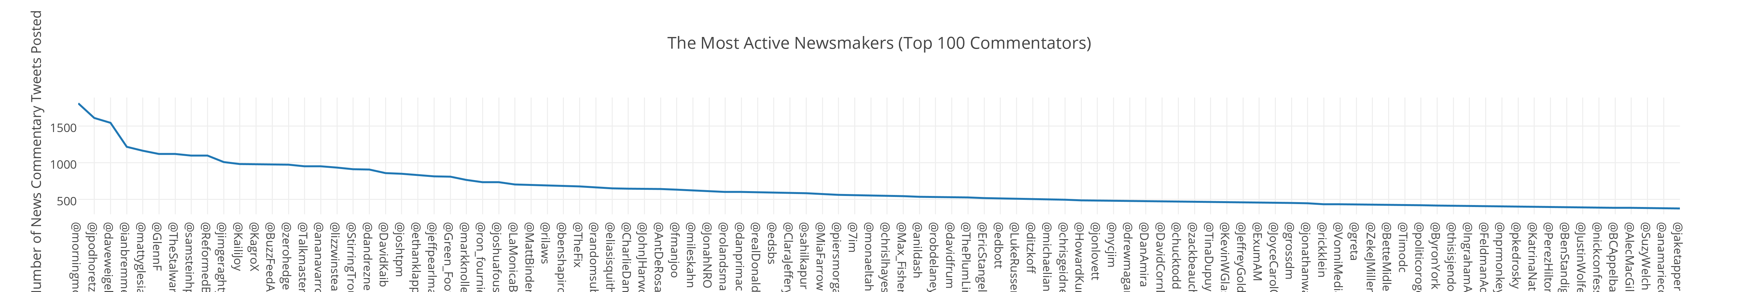

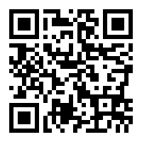
All the Commentaries That's Fit to Tweet
Center for Discovery Science and Health Informatics
TALHA OZ, Computational Social Science
George Mason University
Abstract
Agenda-setters and “framing contestants” have been fighting in a new hot battlefield, Twitter, to promote their agenda and make others see the events through the lenses they offer. This study exploits this new agenda-setting avenue by analyzing two years of public newsworthy commentaries (tweets) of selected opinion-shapers and newsmakers residing in the U.S. and in Turkey. Tweets are manually curated by the editors of theplazz.com and nediyor.com news sites, and commentaries are placed below the related news contents. 156,480 curated tweets of 1,400 influential Americans who have commentated on 7,464 headlines between January 2013 and January 2015 are collected from theplazz.com. For the same period of time, 169,849 commentary tweets of 1,296 influential Turks on 12,000 events that have made to the headlines as well as the corresponding news contents published at nediyor.com are scraped. Using these datasets, first, a novel method to quantify the importance of news for a country is introduced based upon the elitist theory of democracy by analyzing the dynamics of the responses to important events that have made to the headlines in these two countries. Then as case studies, overall distributions of commentaries on different topics are examined, in particular, characteristics of the most appealing news to US newsmakers and that of Turks in the years of 2013 and 2014 are discussed. Moreover, coherence and diversity within groups and inter-groups are measured as a wide range of professionals are covered in the datasets, including journalists, academicians, politicians, businessmen and the artists, by asking questions such as “do members of a political party (or journalists of a news group) flock together, i.e. commentate on the same news? How can we measure the distance of a news group to a political party?” Furthermore, as an attempt to recontextualize the agenda-setting theory in this new avenue, I took a network theoretic approach and created weighted co-commentation networks for different groups, where the nodes of a graph are the members of group(s) examined, and the weighted links are the number of common events that they have commentated on Twitter. In support of these theories, application of a modularity based community detection algorithm on such a network consisting of members of 113th Congress reveals that among monitored 36 democratic and 30 republican Congress members, 95% of them are found to be in the same group as their co-party members. Furthermore, these networks enable us to scale the partisanship of individuals as well as groups. Last but not least, qualitative content analysis on the most descriptive events (politically polarized news) shed light onto the peculiar sensitivities of the groups.
METHODOLOGY
Websites scraped
Members of Congress (MCs) are identified using several public Twitter lists.
Two networks (one-mode and two-mode) are created for the congress members.
In the two-mode network, events are events that made to the headlines and actors are MCs.
One-mode network edges are weighted by the common events that incidents commentate on.
Community detection algorithm is employed on the one-mode network and visualized by Gephi.
ERGM is applied to bipartite network to see the party-effect on the tie formation.
myModel <- ergm(two_mode~edges+b1nodematch("party", diff=T))
Results
title date (D - R)
Republicans call Obama executive action illegal 2014-11-20 -9
Tweeps wish US’ 40th prez a happy birthday 2014-02-06 -9
Sign up trouble? WH extends deadline again 2014-03-25 -8
Britain’s Iron Lady dies of stroke at 87 2013-04-08 -8
Late filers beware: The taxman cometh 2014-04-15 -8
SCOTUS rules for prayer at public meetings 2014-05-05 -7
National Day of Prayer offers controversy, unity 2014-05-01 -6
GOP calls for ‘permanent delay’ of ObamaCare 2013-07-10 -6
WH may not cooperate with Benghazi probe 2014-05-05 -6
Repubs squelch short-term budget fix 2013-02-05 -6
Shinseki resigns from VA following apology 2014-05-30 -6
Boehner pressed for Obamacare alternative 2013-12-03 -5
Sudan detains Christian woman after release 2014-06-24 -5
214 days later: Mexican court frees Tahmooressi 2014-11-01 -5
Obama extends to 2016 ACA employer mandate 2014-02-10 -5
Obamacare head steps down from HHS 2014-04-10 -5
Vets at WWII Memorial become props in dispute 2013-10-02 -5
SCOTUS curbs Obama’s recess appointments 2014-06-26 -5
After IG report, calls for Shinseki to resign 2014-05-28 -5
A Presidential icon, now gone for a decade 2014-06-05 -5
CBO: O’care kills equivalent of 2M jobs 2014-02-04 -5
House holds Lerner in contempt of Congress 2014-05-07 -5
March for Life continues despite cold weather 2014-01-22 -5
House Republicans push Benghazi committee 2014-05-08 -4
Obamacare’s employer mandates delayed 2013-07-02 -4
GOP to form special Benghazi committee 2014-05-02 -4
Thousands gather on Washington Mall 2013-02-17 -4
Will beheadings become call to action for Obama? 2014-09-02 -4
O’care figures frustrate pro’bama fact checkers 2014-02-24 -4
IRS to investigators: Can’t find Lerner’s emails 2014-06-13 -4
..
Gun control in focus 2 years after Sandy Hook 2014-12-14 8
Senate advances bill to extend jobless aid 2014-01-07 8
SOTU puts spotlight on min. wage, gender gap 2014-01-29 8
Obama to governors: ‘sequester hurts states’ 2013-02-25 9
Paycheck Fairness Act voted down by GOP 2014-04-09 9
Secret US-China climate agreement unveiled 2014-11-12 9
Senate’s unemployment bill defeated by 1 vote 2014-02-06 9
Exec. order ends federal LGBT job discrimination 2014-07-21 9
Politicos, businesses thank teachers, nurses 2014-05-06 9
Sundown ushers in the Jewish New Year 2014-09-24 10
LGBT non-discrimination act clears Senate hurdle 2013-11-04 10
Nobel Peace Prize goes to child rights activists 2014-10-10 10
World AIDS Day to raise awareness, funds 2014-12-01 10
Obama to tackle LGBT job discrimination 2014-06-16 11
Military sexual assault bill rejected by Senate 2014-03-06 11
ENDA clears first hurdle, Senate votes 64-32 2013-11-07 11
#WomensEqualityDay marks suffrage anniv. 2014-08-26 11
Renowned poet, author Maya Angelou dies 2014-05-28 12
‘Not My Boss’ Business Act’ shot down in Senate 2014-07-16 12
College affordability makes Dem agenda 2014-05-05 12
SCOTUS rules in favor of Hobby Lobby 2014-06-30 12
The Civil Rights Act of 1964 turns 50 2014-07-02 12
SCOTUS ends overall campaign donor limits 2014-04-02 12
Deportation to focus on ‘felons not families’ 2014-11-20 13
Earth Day observers consider climate change 2014-04-21 13
Dems tweet support for ‘Not My Boss’ Business’ 2014-07-14 13
Dems host climate-change talk-a-thon 2014-03-10 15
Senate passes 5-month UI extension 2014-04-07 17
Dems’ attempt to raise minimum wage fails 2014-04-30 18
Dems push #EqualPay bill on Equal Pay Day 2014-04-08 19
Name: twhandle, dtype: int64
95% of the MCs are found to be in the same group as their co-party members
ERGM (Monte Carlo MLE) also estimates that a MC is more likely to comment on the topics that his/her co-party members also commentated on (statistically significant)
==========================
Summary of model fit
==========================
Formula: two_mode ~ edges + b1nodematch("party”)
Iterations: 20 out of 20
Monte Carlo MLE Results:
Estimate Std. Error MCMC % p-value
edges -4.82148 0.02591 1 <1e-04 ***
b1nodematch.party 0.31572 0.02996 1 <1e-04 ***
---
Signif. codes: 0 ‘***’ 0.001 ‘**’ 0.01 ‘*’ 0.05 ‘.’ 0.1 ‘ ’ 1
Null Deviance: 674870 on 486816 degrees of freedom
Residual Deviance: 52736 on 486814 degrees of freedom
AIC: 52740 BIC: 52762 (Smaller is better.)
INTRODUCTION
Agenda-setting (media -> public)
First level : What to think about
Second level : How / Framing Theory
Agenda-building (reciprocal)
Political actors, interest groups, media, public
Propaganda/ Deliberation
Manipulation of significant symbols
Interaction in search for the solution
RESEARCH QUESTIONS
How to identify what events are important to influencers (newsmakers) of a country and how similar/different they are compared to others (within-nation and across-nations)?
How to test agenda-building theory by measuring and modeling agenda-building efforts of politicians using social media?
DATASETS
http://talhaoz.com/news
References
W. Russell Neuman et al., “The Dynamics of Public Attention: Agenda-Setting Theory Meets Big Data,” Journal of Communication 64, no. 2 (April 1, 2014): 193–214, doi:10.1111/jcom.12088.
David R. Hunter et al., “Ergm: A Package to Fit, Simulate and Diagnose Exponential-Family Models for Networks,” Journal of Statistical Software 24, no. 3 (2008): 1–29.
Bastian, Mathieu, Sebastien Heymann, and Mathieu Jacomy. "Gephi: an open source software for exploring and manipulating networks." ICWSM 8 (2009): 361-362.
Machine Learning and Inference Laboratory
College of Health and Human Services
http://mason.gmu.edu/~toz
4400 University Dr. MSN 1J3
Fairfax, VA 22030 USA

